Slide 1
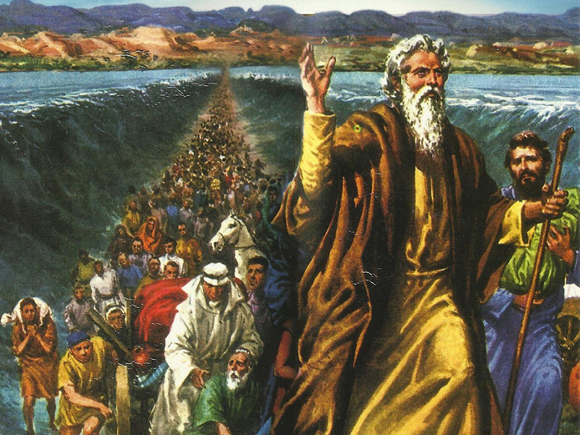
CATECHETICAL TEXTBOOK SERIES OF THE SYRO - MALABAR CHURCH
ON THE PATH OF SALVATION - 5
PEOPLE WHO AWAITED THE REDEEMER
5

Slide 2
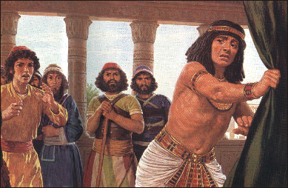
LESSON 4
PEOPLE OF ISRAEL IN EGYPT

Slide 3
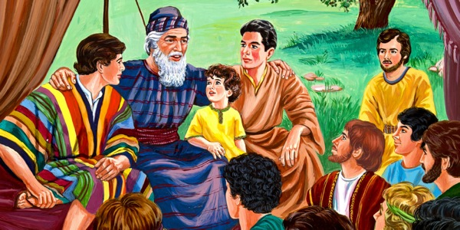
Jacob had 12 children Ruben - eldest and Benjamin – youngest. But Jacob loved “Joseph” very much. So he had given him long rob with sleeves as a sign of his favor. Joseph’s brothers began to hate him because of their father’s favoritism towards him.

Slide 4
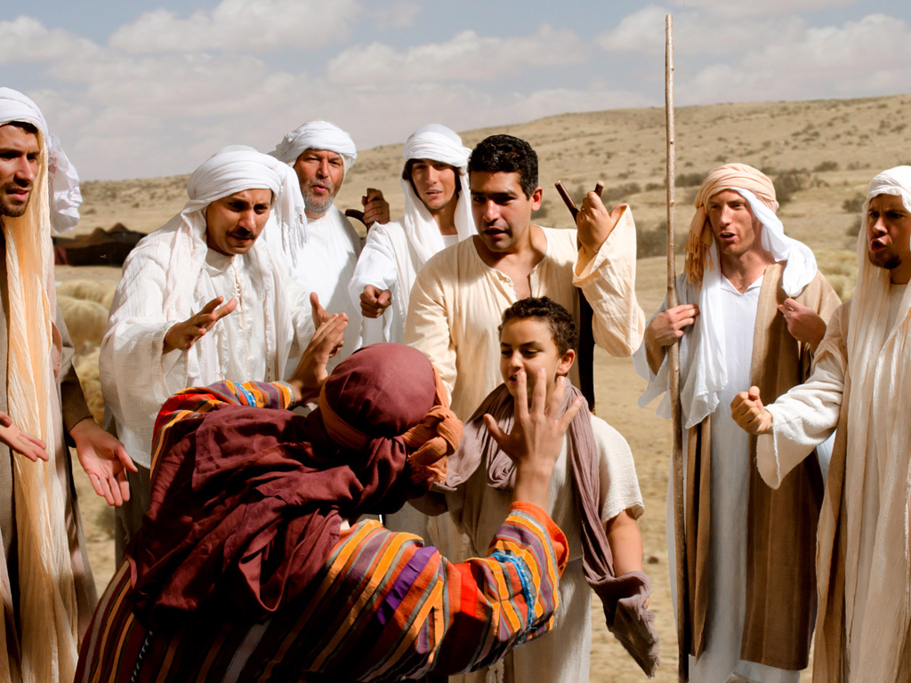
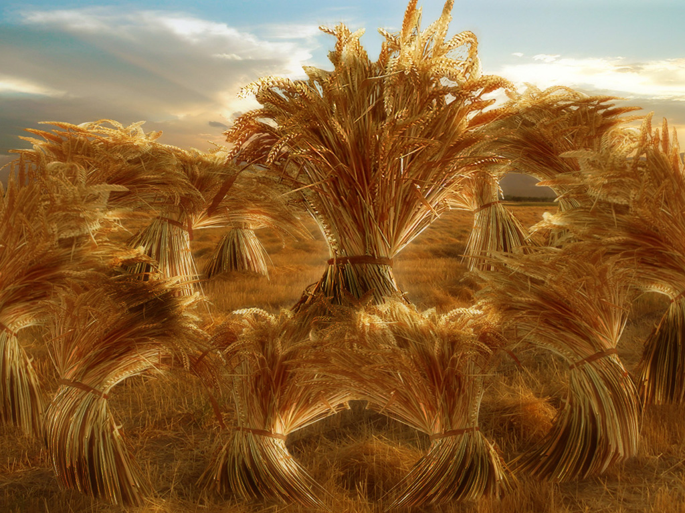
Joseph’s dream
“There we were binding sheaves in the field. Suddenly my sheaf rose and stood uprights; then your sheaves gathered around it and bowed down to my Sheaf”.

Slide 5
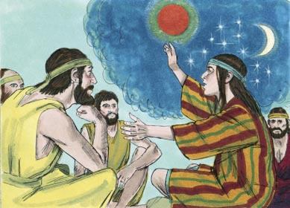
Joseph’s Second dream
“ The sun, moon and eleven stars were bowing down to me”
His brothers felt all the more jealous of him.

Slide 6


Slide 7
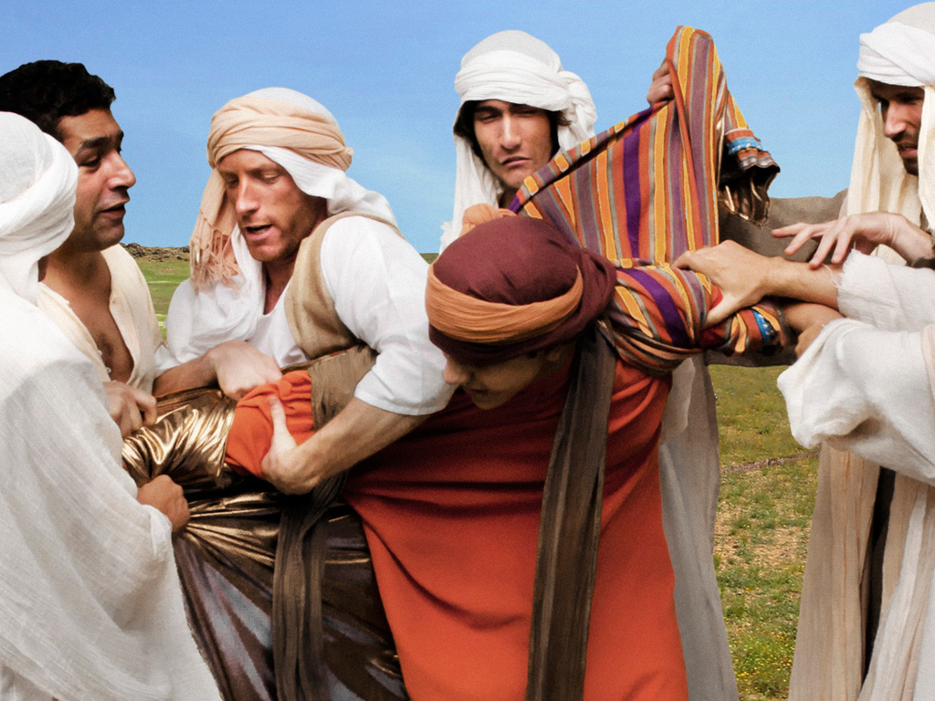
Joseph’s brothers hated him because of his dreams and his words.

Slide 8
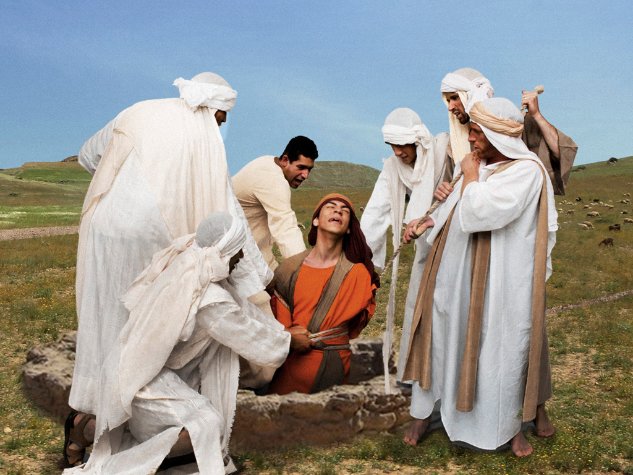
JOSEPH IN EGYPT
One day Joseph went to these brothers who were grazing their sheep far from home. When they saw him afar they conspired to kill him. But Ruben the eldest forbade this. So they took his special robe from him and threw him into the pit. Then a group of traders going to Egypt came that way. So they recused Joseph from the pit and sold him to the traders who took him to Egypt.

Slide 9
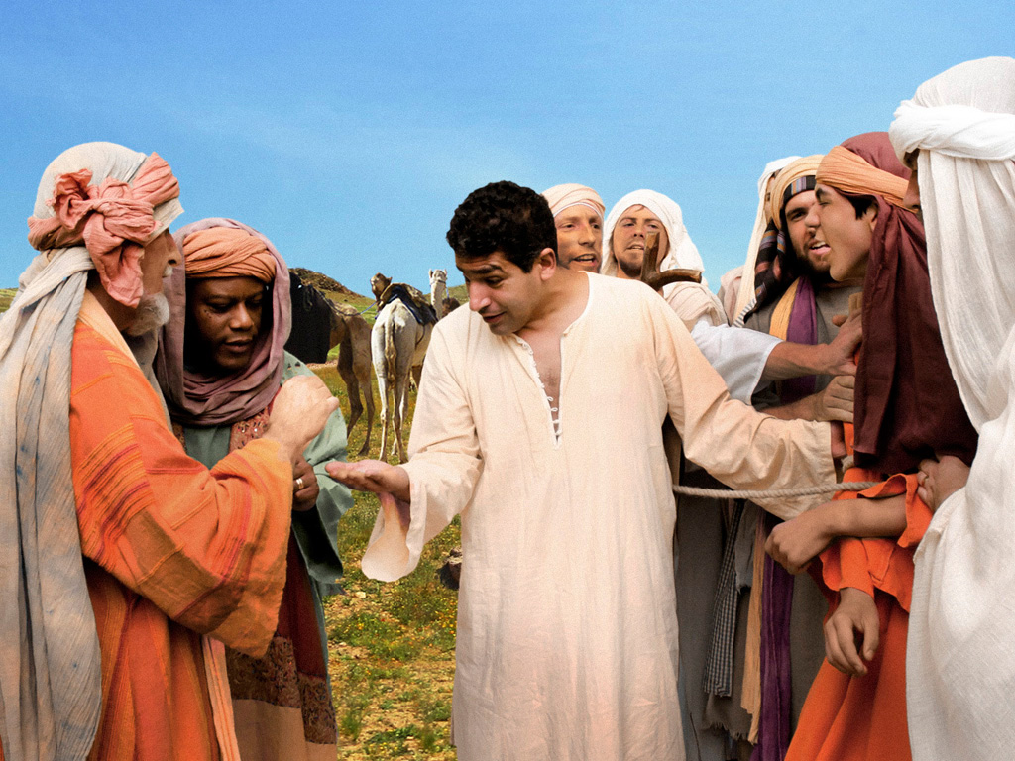
The traders sold Joseph to the Potiphar, an officer of Pharaoh and captain of the guard. Lord God was with Joseph and so he excelled in all that he did.

Slide 10
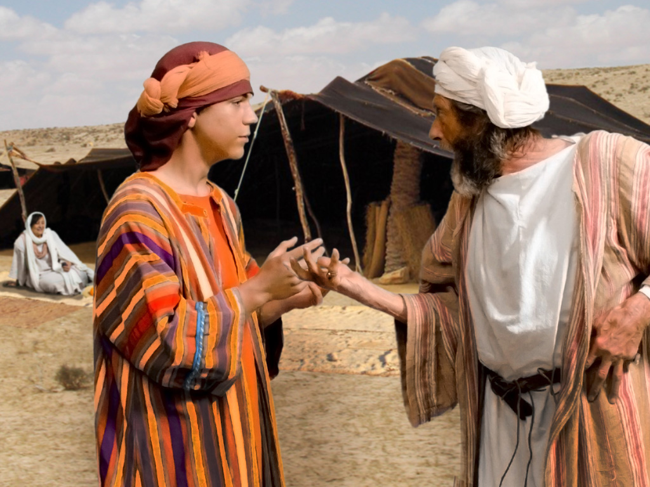
Seeing that joseph was efficient and good, Potiphar made joseph his overseer and entrusted all he had to his care. Potiphar's wife got interested in Joseph as he was handsome and good looking and requested him to sleep with her.
As Joseph never yielded to her wish, she told lie about him to Potiphar who then put Joseph in prison.

Slide 11
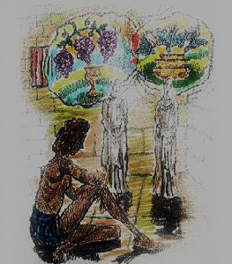
INTERPRETING DREAMS
The lord was kind to Joseph and he found favour with the jailer. The jailor entrusted the supervision of the prisoners to Joseph. The Lord made him prosper in everything he did.
In jail he interpret the dream of Pharaoh’s chief cook and his cupbearer. His interpretation was proved correct soon after.

Slide 12
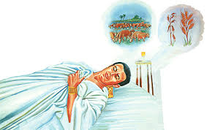
After two years Pharaoh had a dream. Hew knew about Joseph through the chief cook and he sent immediately for Joseph and ask him to interpret. Joseph interpret the dream correctly and given him the advises to face the problem of the dream.

Slide 13
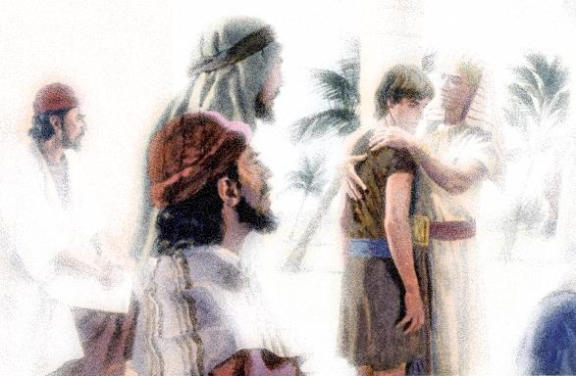
Joseph: Governor of Egypt
Pharaoh was pleased Joseph’s suggestions and appointed him the Governor of Egypt. To survive the years of famine Joseph collected and stored foodstuff in all the cities of Egypt. After seven years what Joseph told that happened in Egypt.
Meanwhile Joseph got married and had two son; - Manasseh & Ebraim.

Slide 14
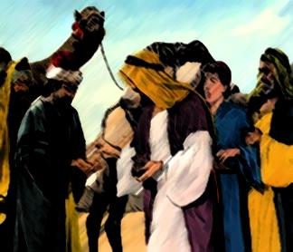
ISRAEL TO EGYPT
Jacob heard that there is grain in Egypt and he sent his sons to collect grains from Egypt without knowing about Joseph. But Joseph recognized his brothers but they did not. He subjected them to many tests and tricks and the end he revealed himself. And he inform them his desire to see his father.(Gen.45 &46).

Slide 15
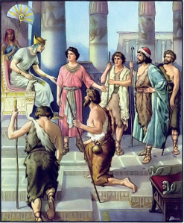
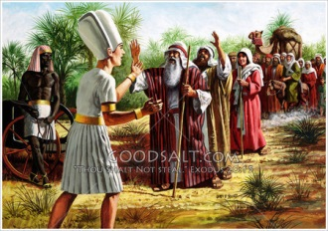
Joseph asked his brothers to bring his father also and his brothers described every thing to his father and he wanted to see his favorite son –Joseph. Jacob collected all his property and proceeded to Egypt.
On the way God spoke to Jacob in a vision “Do not be afraid to go down Egypt, for I will make of you a great nation there. I my self will go down with you to Egypt’’.

Slide 16
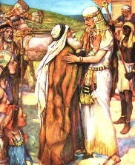
When Jacob arrived in Egypt Joseph received him in great joy. As per the decree of Pharaoh a region of the land was given to Jacob and his children. The land given to them, called Ramses was the most fertile region of Egypt. Jacob lived in Egypt for seventeen years more. Israel become very rich there.
Joseph came to Egypt as a slave and he had many problem there even a long prison term. but the end he become the chief administrator over there.

Slide 17

The life of Joseph makes it clear to us that the ways of the Lord are indeed miraculous. It was through Joseph that God prepared the way for Israel to reach Egypt. That was Joseph’s share in God’s plan of salvation.

Slide 18
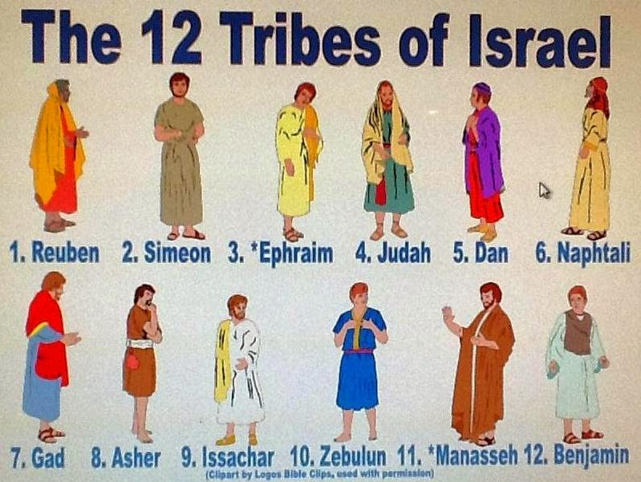
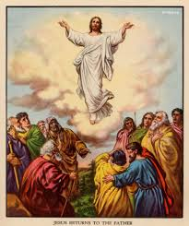
TWELVE TRIBES AND APOSTLES
12 sons of Jacob’s became the 12 tribes of Israel.
This 12 tribes have great importance in the history of salvation.
The people of God in the old testament were led by the heads of the 12 tribes and their descendants.
In the same way the people of God in the new testament are led by 12 apostles and their successors.

Slide 19

What we see in the New testament is the fulfillment of the old testament. As we learn the old testament history we should try to understand properly God’s plan of salvation. We should also realize that today it is through us that God’s plans are being fulfilled and we must offer our lives for that cause.

Slide 20
Let us pray
O’God, who protects us in all the situations of our life, help us to be faithful in our life.

Slide 21
READ AND RECOUNT
Narrate how Joseph revealed himself to his brothers who came to Egypt. (Gn.44:1-34).

Slide 22

WORD OF GOD FOR GUIDANCE
God of your father will help you and bless you with the blessings of heaven above. (Genesis 49:25).

Slide 23
MY DECISION
Like Joseph dealt Lovingly with those who maltreated him I will also deal lovingly with those treat me bed.

Slide 24
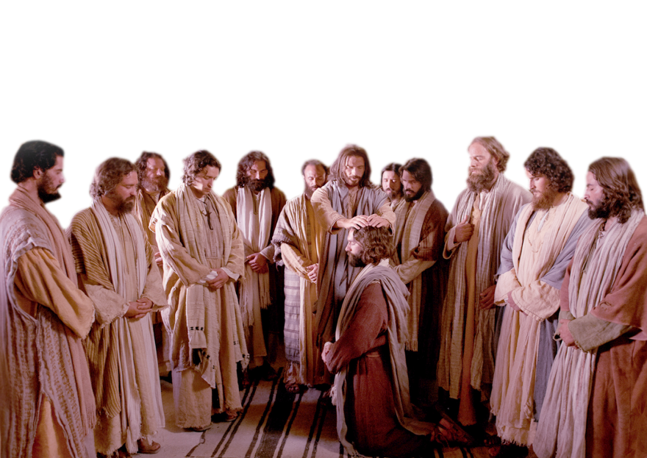
LET US DO
Find out the names of the apostles from the bible and write down in the columns below.
…………………………..
…………………………..
…………………………..
…………………………..
…………………………..
…………………………..
…………………………..
…………………………..
…………………………..
…………………………..
…………………………..
…………………………..

Slide 25
LET US FIND OUT THE ANSWER
1. What was the interpretation that Joseph gave to Pharaoh’s dream?
2. Why did Jacob’s sons went to Egypt?
3. What did God say to Jacob on his journey to Egypt?
4. As per the divine plan what does the life story of Joseph communicate to us ?
5. Who are the persons who guide the church, the New Testament people of God, in the place of Old Testament fathers?

Slide 26



Thank you

